Slide 1
Just in Time Systems
Prof. Raza Khan
Operations Management
Lecture 4
Notes:
1

Slide 2
Outline
JIT Case Discussion
  “JUST IN TIME – The Ultimate Production System”
  JUST IN TIME at Wiremold
Affinity Diagram Presentation
  Overview of Interrelationship Digraph and Tree Diagram (from last lecture)
Just-in-Time/Lean Production Systems
Prof. Raza Khan
Operations Management
Lecture 4

Slide 3
Case Discussion
“JUST IN TIME – The Ultimate Production System”
JUST IN TIME at Wiremold
We will discuss important concepts covered in these articles.
Prof. Raza Khan
Operations Management
Lecture 4

Slide 4
Just in Time (JIT)
Produce (or order) right items in the right quantities at the right time at the right place
Prof. Raza Khan
Operations Management
Lecture 4

Slide 5
Just-In-Time (JIT)
Defined
JIT can be defined as an integrated set of activities designed to achieve high-volume production using minimal inventories (raw materials, work in process, and finished goods)
JIT also involves the elimination of waste in production effort
JIT also involves the timing of production resources (i.e., parts arrive at the next workstation “just in time”)
Prof. Raza Khan
Operations Management
Lecture 4
Notes:
3

Slide 6
JIT and Lean Management
JIT can be divided into two terms: “Big JIT” and “Little JIT”
Big JIT (also called Lean Management) is a philosophy of operations management that seeks to eliminate waste in all aspects of a firm’s production activities: human relations, vendor relations, technology, and the management of materials and inventory
Little JIT focuses more narrowly on scheduling goods inventory and providing service resources where and when needed
Prof. Raza Khan
Operations Management
Lecture 4
Notes:
3

Slide 7
JIT Demand-Pull Logic
Here the customer starts the process, pulling an inventory item from Final Assembly…
Then sub-assembly work is pulled forward by that demand…
Fab
Vendor
Sub
Fab
Vendor
Final
Assembly
Customers
The process continues throughout the entire production process and supply chain
Sub
Fab
Vendor
Fab
Vendor
Prof. Raza Khan
Operations Management
Lecture 4
Notes:
4

Slide 8
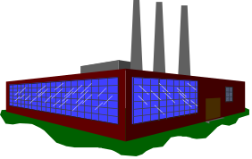
Supplier – Production – Distribution System
Productions Inventories
Customer Distribution
Inventories
Supplier Distribution
Inventories
Raw Material
Inventory
Work-in-process
Inventory
Factory
Finished
Goods
Inventory
Retailer
Inventory
Raw material
in-transit
Orders
Component
Inventory
Sub-assembly
parts in-transit
Warehouse
Inventory
MRO
Inventory
Orders
Maintenance,
repair, and ordering
supplies in-transit
Production and
Inventory Control
Shipping and
Traffic
Purchasing
Prof. Raza Khan
Operations Management
Lecture 4
Notes:
7

Slide 9
JIT
Objective of achieving plus or minus zero performance to schedule.
Ideal lot size of one piece to:
  Minimize inventory investment
  Shorten production lead times
  React faster to demand changes
  Uncover any quality problems
Primarily applied to repetitive manufacturing where varied volumes of same parts are produced over and over again.
Prof. Raza Khan
Operations Management
Lecture 4

Slide 10
Lowering Inventory
Reduces Waste
Work in process inventory level
(hides problems)
Unreliable Vendors
Capacity Imbalances
Scrap
Prof. Raza Khan
Operations Management
Lecture 4
Notes:
34

Slide 11
Lowering Inventory
Reduces Waste
Reducing inventory reveals
problems so they can be solved.
WIP
Unreliable Vendors
Capacity Imbalances
Scrap
Prof. Raza Khan
Operations Management
Lecture 4
Notes:
35

Slide 12
Lowering Inventory
Reduces Waste
Reducing inventory reveals
problems so they can be solved.
Unreliable Vendors
WIP
Capacity Imbalances
Scrap
Prof. Raza Khan
Operations Management
Lecture 4
Notes:
36

Slide 13
Just-in-Time (JIT) – Key Requirements
Eliminate Waste in Processing
  All classes of waste
On-time delivery is emphasized
Reduces all inventory levels
  Inventory hides process & material problems
  Reduce process variability
Organize for Flow Production
  Strive for in-line processing with verification at each step
  Move processes closer together
  Group Technology
  Small lot sizes
  Quick changeover (setup) time
  Preventive Maintenance
Prof. Raza Khan
Operations Management
Lecture 4
Notes:
31

Slide 14
Just-in-Time (JIT) – Key Requirements Contd.
Level (balance) Schedule Production
  Leveling means both the volume of production and the types of products are evenly distributed over the operation time
  Dampens the shock wave effect, e.g. final assembly
  Requires balancing the capabilities of the various stages in the production process
  Requires standardized operations and processing procedures
  Underutilize capacity
Pull’ system of production/purchasing - Kanban
  Customer starts production with an order
Quality at the Source
  Workers have authority to stop the line in case of an abnormality
  Poka-yoke (fail-safe) methods
  Autonomation
  One piece focus
Prof. Raza Khan
Operations Management
Lecture 4

Slide 15
Just-in-Time (JIT) – Key Requirements Contd.
Involves ‘vendor partnership programs’ to improve quality of purchased items
  On-time deliveries-supplier informed of schedules
  Strategic partnerships
  Recognition
Continuously improves process & product quality (DRPT– Remove all kinds of waste!)
Respect for people!
  Empowerment, cross training support
Prof. Raza Khan
Operations Management
Lecture 4

Slide 16
Minimizing Waste: Just-In-Time Production
Management philosophy
“Pull” system through the plant
WHAT IT IS
Attacks waste
Exposes problems and bottlenecks
Achieves streamlined production
WHAT IT DOES
Employee participation
Industrial engineering/ basics
Continuing improvement
Total quality control
Small lot sizes
WHAT IT REQUIRES
Stable environment
WHAT IT ASSUMES
Prof. Raza Khan
Operations Management
Lecture 4
Notes:
13

Slide 17
Layout
JIT objective: Reduce movement of people and material
  Movement is waste!
JIT requires
  Work cells for product families
  Moveable or changeable machines
  Short distances
  Little space for inventory
  Delivery directly to work areas
Prof. Raza Khan
Operations Management
Lecture 4
Notes:
29

Slide 18
Work Cell versus
Process Layout
Process Layout
Work Cell
1
Lathe
Saw
2
Lathe
Saw
Saw
Press
2
5
4
Heat
Lathe
Lathe
Treat
Grinder
3
1
Press
Grinder
Heat
6
Treat
Press
Grinder
Prof. Raza Khan
Operations Management
Lecture 4
Notes:
30

Slide 19
JIT Inventory Reduction
Use a pull system to move inventory
Reduce lot size
Reduce setup time
Develop Just-in-Time delivery systems with suppliers
Deliver directly to point of use
Perform-to-schedule
Use group technology
Prof. Raza Khan
Operations Management
Lecture 4
Notes:
33

Slide 20
To Lower Inventory
Reduce Lot Sizes
Inventory Level
Average inventory = 40
Lot Size 200
Average inventory = 100
Lot Size 80
Average inventory = (Lot size)/2
Time
Prof. Raza Khan
Operations Management
Lecture 4
Notes:
37

Slide 21
Reducing Lot Sizes Increases the Number of Lots
Customer orders 10
Lot size = 5
Lot 1
Lot 2
Lot size = 2
Lot 1
Lot 2
Lot 3
Lot 4
Lot 5
Prof. Raza Khan
Operations Management
Lecture 4
Notes:
38

Slide 22
…Which Increases
Inventory Costs
Cost
Total Cost
Holding Cost
Setup Cost
Smaller
Lot Size
Optimal
Lot Size
Lot Size
Prof. Raza Khan
Operations Management
Lecture 4
Notes:
39

Slide 23
Unless Setup Costs are Reduced
Cost
Total Cost
Holding Cost
Setup Cost
New optimal lot size
Original optimal
lot size
Lot Size
Prof. Raza Khan
Operations Management
Lecture 4
Notes:
40

Slide 24
JIT Scheduling
Communicate the schedule to suppliers
Make level schedules
Freeze part of the schedule (Freeze window)
Perform to schedule
Seek one-piece-make and one-piece-move
Produce in small lots
Use kanbans
Make each operation produce a perfect part
Backflush
Prof. Raza Khan
Operations Management
Lecture 4
Notes:
43

Slide 25
Minimizing Waste:
Uniform Plant Loading (heijunka)
Suppose we operate a production plant that produces a single product. The schedule of production for this product could be accomplished using either of the two plant loading schedules below.
Not uniform Jan. Units Feb. Units Mar. Units Total
1,200 3,500 4,300 9,000
or
Uniform Jan. Units Feb. Units Mar. Units Total
3,000 3,000 3,000 9,000
How does the uniform loading help save labor costs?
Prof. Raza Khan
Operations Management
Lecture 4
Notes:
12

Slide 26
Level Scheduling
Reduce ripple effect of small variations in schedules (e.g., final assembly)
Build same mix of products every day
Results in many small lots
  Item Monthly Quantity Daily Quantity Cycle
  Time (min.)
  Sedan 5,000 250 2
  Hardtop 2,500 125 4
  Wagon 2,500 125 4
Prof. Raza Khan
Operations Management
Lecture 4
Notes:
44

Slide 27
Small versus Large Lots
JIT produces same amount in same time if setup times are lowered
JIT Small Lots
A
A
B
B
B
C
A
A
B
B
B
C
Time
Small lots also increase flexibility to meet customer demands
Large-Lot Approach
A
A
A
A
B
B
B
B
B
B
C
C
Time
Prof. Raza Khan
Operations Management
Lecture 4
Notes:
45

Slide 28
Kanban Pull System
Japanese word for card
  Pronounced ‘kahn-bahn’ (not ‘can-ban’)
Authorizes production from downstream operations
  ‘Pulls’ material through plant
May be a card, flag, Kanban square, etc.
Used often with fixed-size containers
  Add or remove containers to change production rate
Prof. Raza Khan
Operations Management
Lecture 4
Notes:
46

Slide 29
Minimizing Waste: Kanban Production Control Systems
This puts the system back were it was before the item was pulled
Once the Production kanban is received, the Machine Center produces a unit to replace the one taken by the Assembly Line people in the first place
Withdrawal
kanban
Storage Part A
Storage Part A
Machine Center
Assembly Line
Production kanban
Material Flow
Card (signal) Flow
The process begins by the Assembly Line people pulling Part A from Storage
Prof. Raza Khan
Operations Management
Lecture 4
Notes:
15

Slide 30
Determining the Number of Kanbans Needed
Setting up a kanban system requires determining the number of kanbans cards (or containers) needed
Each container represents the minimum production lot size
An accurate estimate of the lead time required to produce a container is key to determining how many kanbans are required
Prof. Raza Khan
Operations Management
Lecture 4
Notes:
16

Slide 31
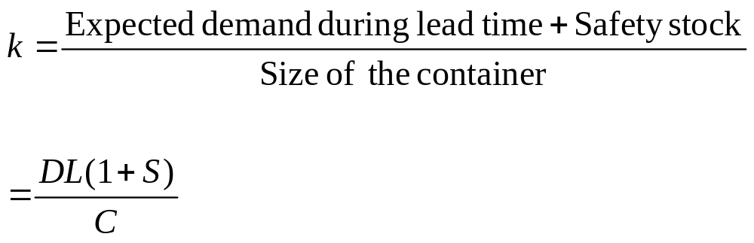
The Number of Kanban Card Sets
k = Number of kanban card sets (a set is a card)
D = Average number of units demanded over some time period
L = lead time to replenish an order (same units of time as demand)
S = Safety stock expressed as a percentage of demand during leadtime
C = Container size
Prof. Raza Khan
Operations Management
Lecture 4
Notes:
17

Slide 32
Example of Kanban Card Determination: Problem Data
A switch assembly is assembled in batches of 4 units from an “upstream” assembly area and delivered in a special container to a “downstream” control-panel assembly operation
The control-panel assembly area requires 5 switch assemblies per hour
The switch assembly area can produce a container of switch assemblies in 2 hours
Safety stock has been set at 10% of needed inventory
Prof. Raza Khan
Operations Management
Lecture 4
Notes:
18

Slide 33
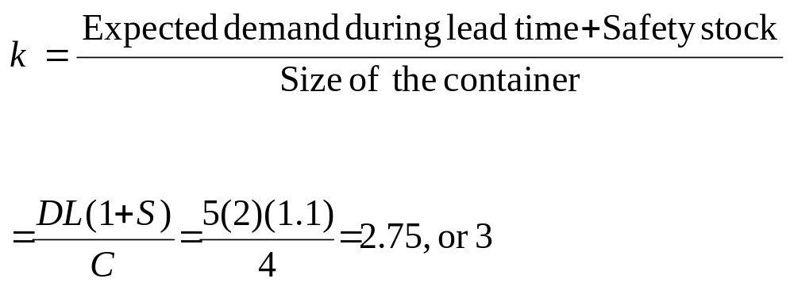
Example of Kanban Card Determination: Calculations
Always round up!
Prof. Raza Khan
Operations Management
Lecture 4
Notes:
19

Slide 34
Preventive Maintenance (PM)
All activities involved in keeping equipment in working order
Done to prevent failure
JIT requires
  Scheduled & daily PM
  Operator performs PM
    Knows machines
    Responsible for product quality
Prof. Raza Khan
Operations Management
Lecture 4
Notes:
47

Slide 35
Quality
JIT exposes quality problems by reducing inventory
JIT limits # defects with small lots
JIT requires TQM
  Statistical process control
  Worker involvement
    Inspect own work
  Immediate feedback
Prof. Raza Khan
Operations Management
Lecture 4
Notes:
48

Slide 36
JIT Reduced Waste at Hewlett-Packard
Waste Reduction (%)
Setup Time
20%
Scrap
30%
Finished Goods Inventory
30%
Space
40%
Lead Time
50%
Raw Material Inventory
50%
Work-in-Process Inventory
82%
0%
20%
40%
60%
80%
100%
Prof. Raza Khan
Operations Management
Lecture 4
Notes:
11

